Slide 1
Digital Portfolio
STUDENT NAME: A.Nazema
REGISTER NO AND NMID: astvu30430424u09017AND/394359
DEPARTMENT: BCA
COLLEGE: AAA college walajapet/Thiruvalluvar University

Slide 2
PROJECT TITLE
My project Tittle is My portfolio This is of my project then my including about education and qualification and work of my project and contact

Slide 3


AGENDA
Problem Statement
Project Overview
End Users
Tools and Technologies
Portfolio design and Layout
Features and Functionality
Results and Screenshots
Conclusion
Github Link
3/21/2024 Annual Review

Slide 4

PROBLEM STATEMENT
My work in define I am that future a portfolio website problem statement focused on the nee for individual and professional to establish a strong online presence by showcasing their work and skills.in to my portfolio to work on my own to any one than including to images so that for easy define in without only me.not to another person

Slide 5

PROJECT OVERVIEW
1. About me: A brief introduction that highlights your background, skills, and experience.
2. Projects: A selection of projects that demonstrate your skills and experience, including descriptions, images, and outcomes.
3. Skills: A list of your relevant skills, including technical, creative, and soft skills.
4. Experience: A summary of your relevant work experience, including job titles, company names, and dates.
5. Achievements: A highlight of your notable achievements, including awards, publications, or recognition

Slide 6

WHO ARE THE END USERS?
My portfolio ending users is Contact this is using of my project queries and dout should be contact me and I include my email address you have sending to my gmail.

Slide 7

TOOLS AND TECHNIQUES
I am using for online tools in codepen.
Techniques:Use semantic elements,Improve accessibility,. Use headings,. Use paragraphs,Use the img element.

Slide 8
POTFOLIO DESIGN AND LAYOUT
My portfolio design in :
Clear purpose,Target audience,Visual identity,Content strategy.
Layout:
Introduction,Project showcases,Navigation,Visual hierarchy,Grid layout,Masonry layout.
8

Slide 9
FEATURES AND FUNCTIONALITY
Futures:
Al-powered portfolio analysis,Cloud-based systems,Sustainability and ESG factors.
Functionality:
Automated data analysis,Predictive analytics,Real-time tracking and adjustment,Enhanced stakeholder engagement,Integration with enterprise architecture.

Slide 10
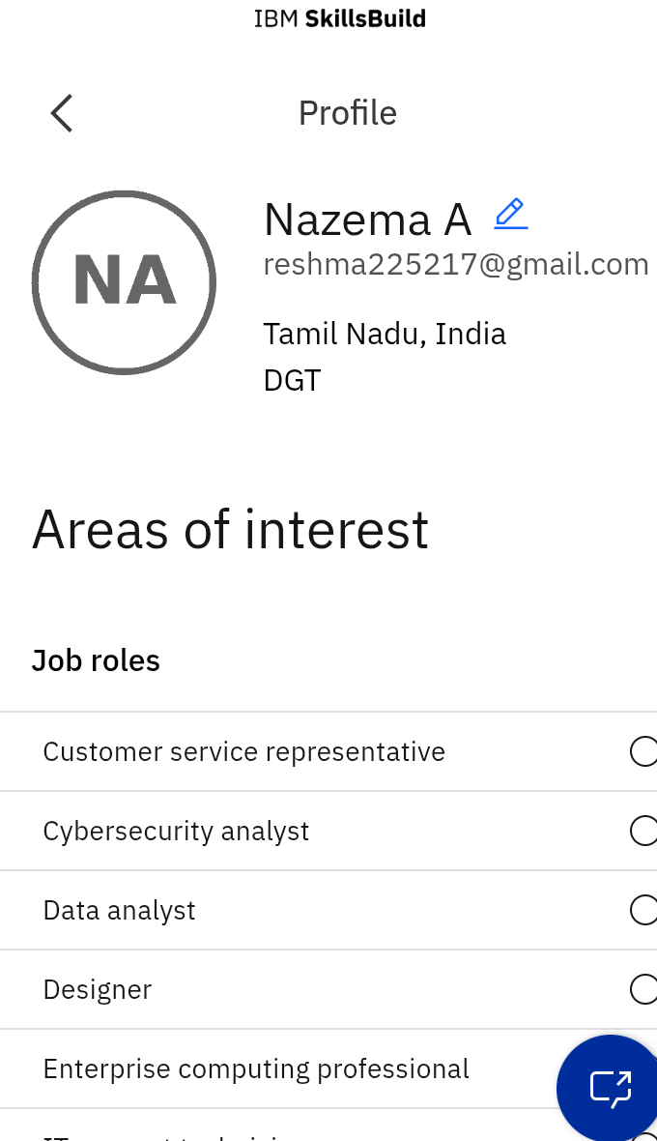
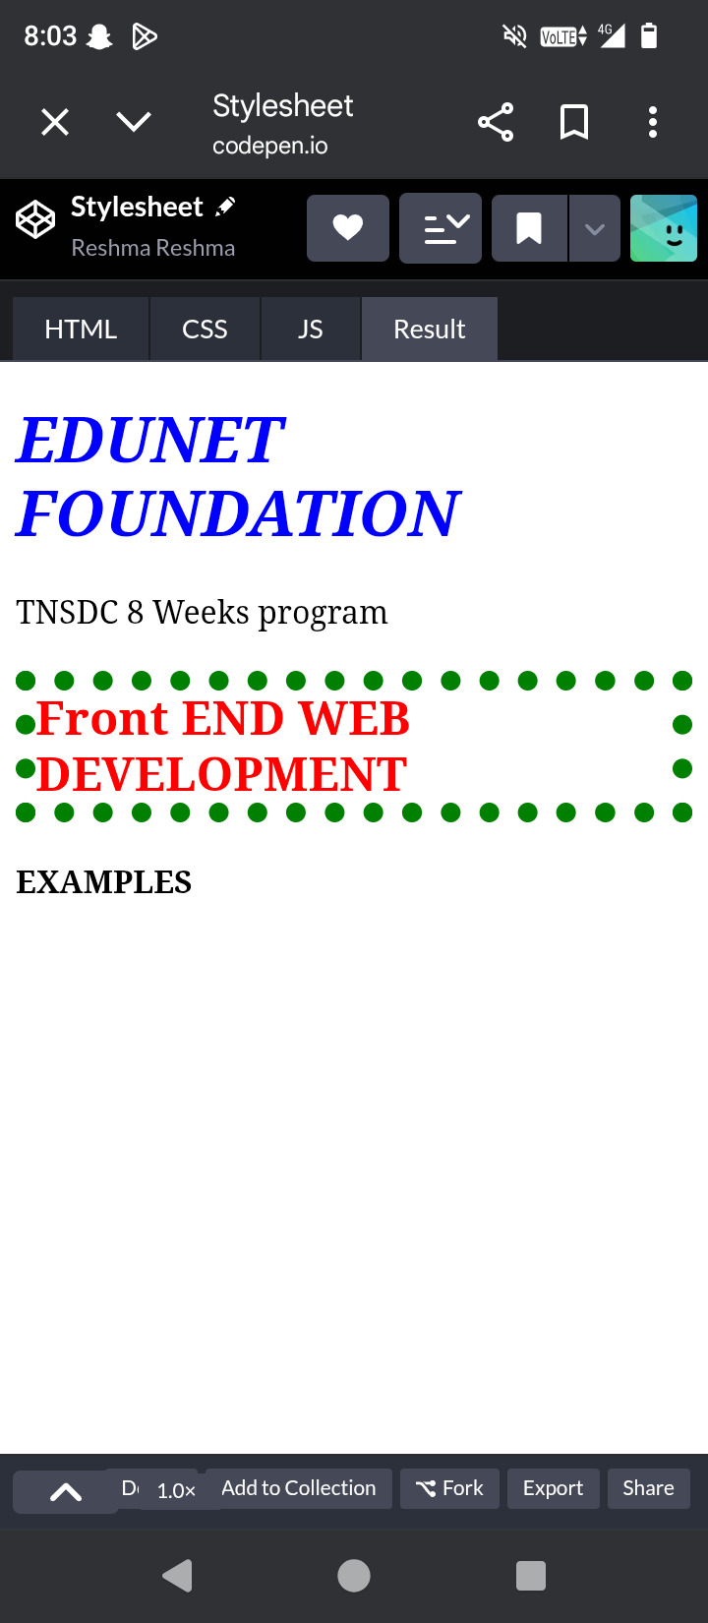
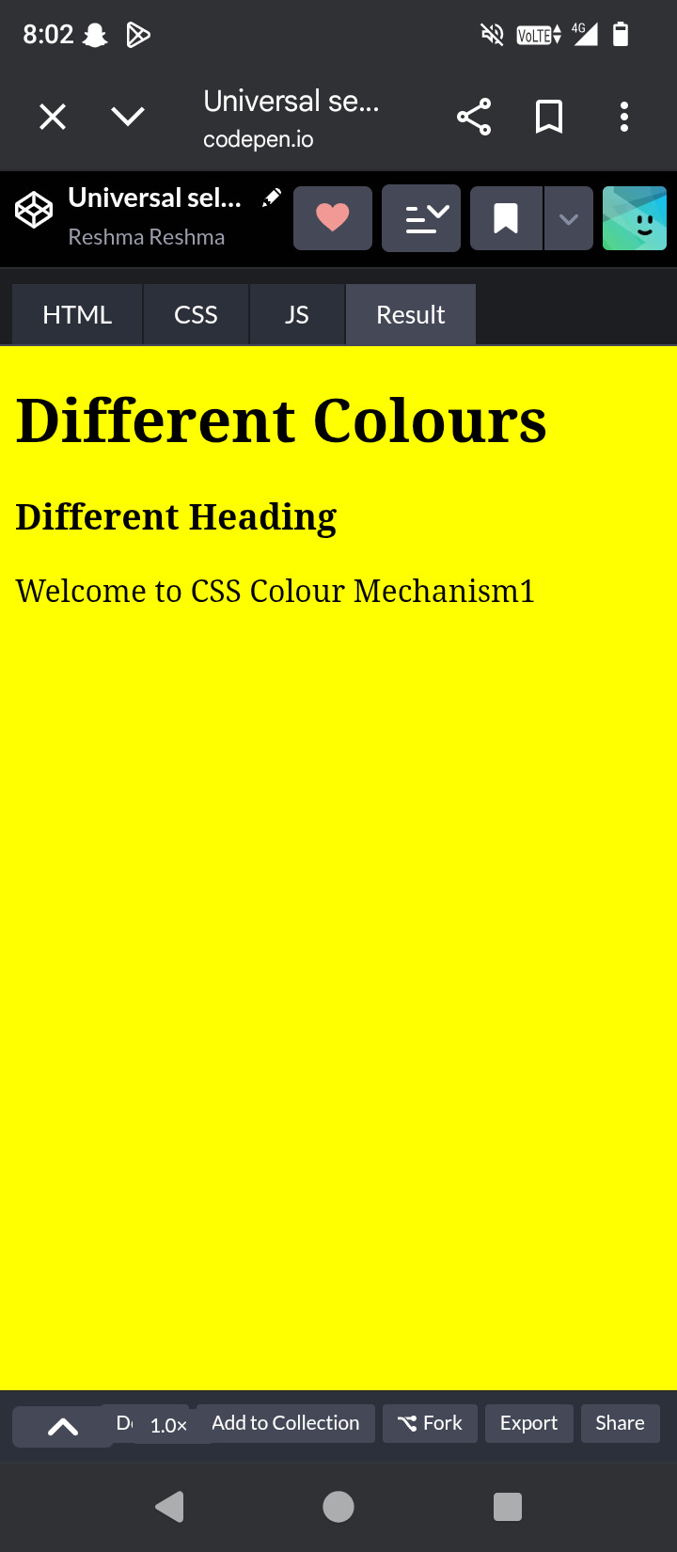

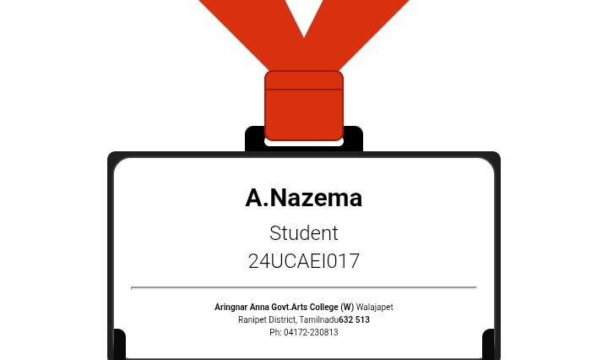

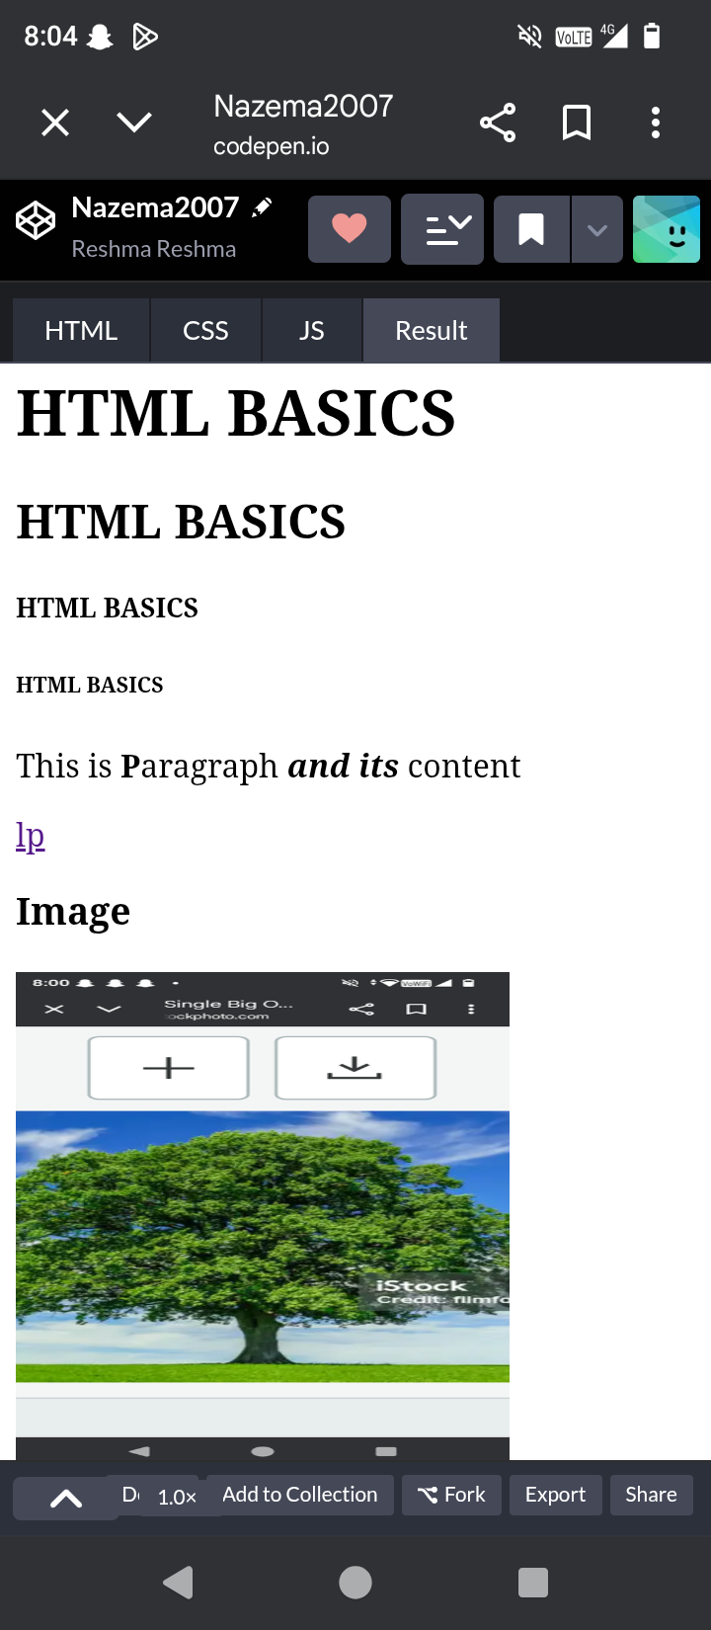
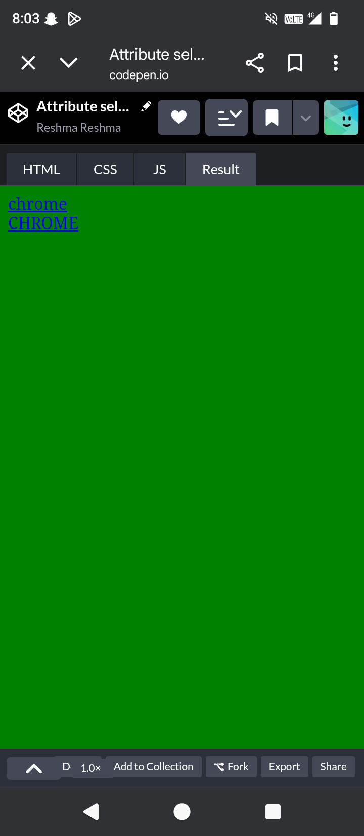
RESULTS AND SCREENSHOTS
3/21/2024 Annual Review
10

Slide 11
CONCLUSION
By following these key elements, best practices, and tips, you can write a portfolio conclusion that effectively summarizes your work and experience, and provides a strong call-to-action for potential employers, clients, or collaborators.
Do you have any specific questions about portfolio conclusions or would you like to know more about a particular aspect of portfolio development
11

